Slide 1
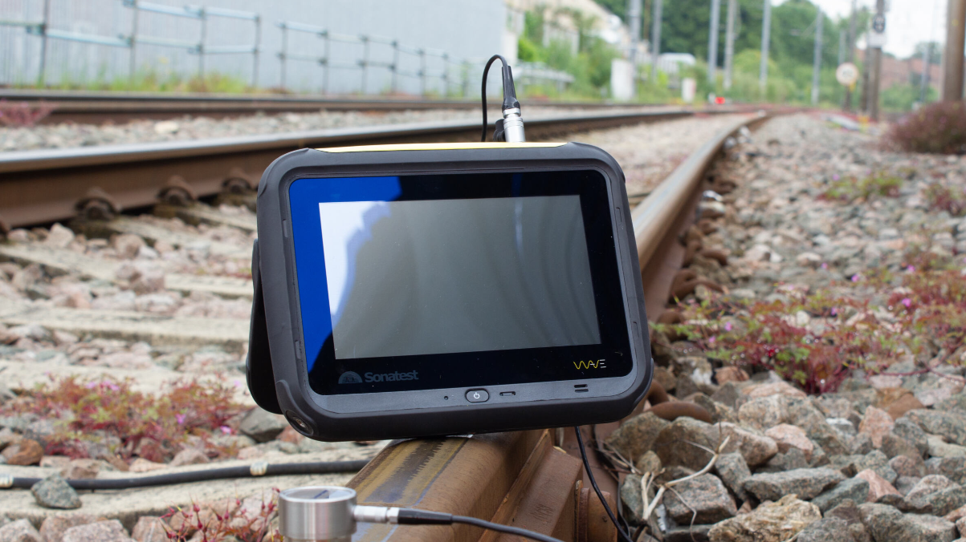
What’s New Wave 2.1 Sonatest Webinar Presentation
Version 2.1
Available on November 13th

Slide 2
Exclusive Content
2 Major Features and Enhancements
Remote API
Exam Mode
Overview of enhancements

Slide 3
Remote API
What is this?
Main Features
Performances
What market and applications?

Slide 4
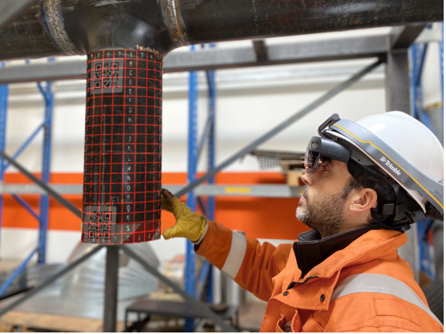
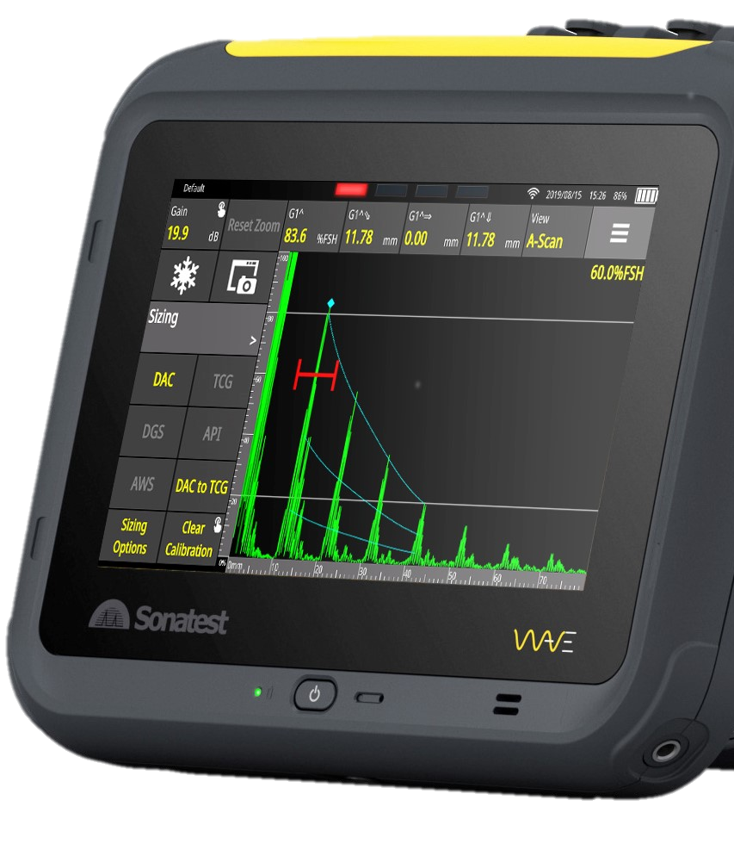
Sonatest is ahead again
Your world is digital and connected, and so is your WAVE
The era of pen & paper is fading away. Today’s technicians are embracing digital technologies and Sonatest empowers them to achieve their full potential

Slide 5
Remote API
Remote Application Protocol Interface
Communication purposes
Can be input and/or output
Performance may vary depending on the technology
Old technology (RS-232) or latest?
MQTT v5.0

Slide 6
API - Network Setup

Slide 7
API - Network Setup

Slide 8
MQTT is featuring…
Read and Write to 60 parameters so far
Read Freeze state (Wave output) → Off → Enable Freeze (Wave Input)
Write Scanning gain to 56.6 dB
Write TCG points, etc.
Stream the 4 top menu measurements
Change measurement upon request
Stream raw A-scan data

Slide 9
Performance
Communication at Wave refresh Rate
Full A-scan data at 60Hz
Full parameter control at 60 Hz
Slower in conditions of poor Wi-Fi or low PRF.
Allow > 3.5 MB/s

Slide 10
New Markets? Yes!
Integrators – NDT specialists
Offshore Applications
Fully automated crawler
Immersion – QA Manufacturing
Wind Energy
Aerospace parts
AR & Incoming Technologies – High-End Service Companies
Quasset
Colleges and Universities

Slide 11
Rope Access Applications
Instant feedback
VNC + API Control
Easy Teamwork
Instant Data Capture for fast Reporting
On the Edge & High-End Service
Job Done & Sent

Slide 12
New Applications - Automation
NDT 4.0
Wave to be 100% integrated to an automated process
Providing Traceability
Dynamically Controlled

Slide 13
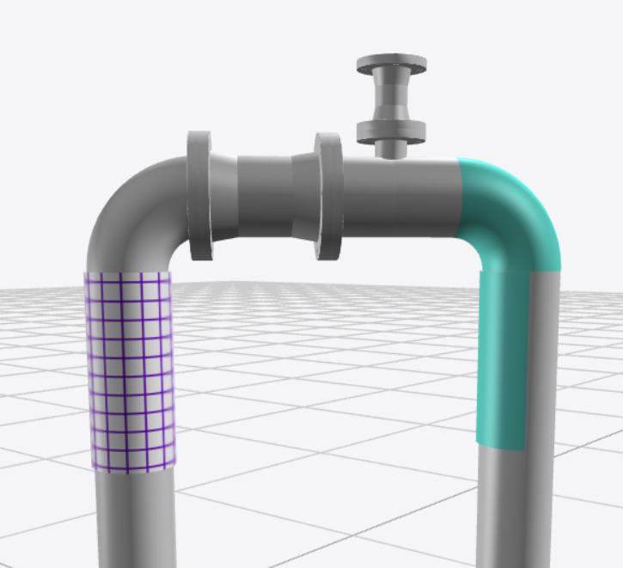
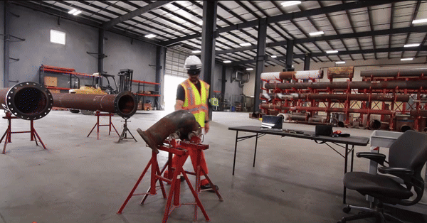
Incoming Technologies
Augmented Reality
Idem again with reporting

Slide 14
Research & Smart Innovations
Universities
Colleges
Companies with R&D Labs
New Software on App Store/Google Store

Slide 15
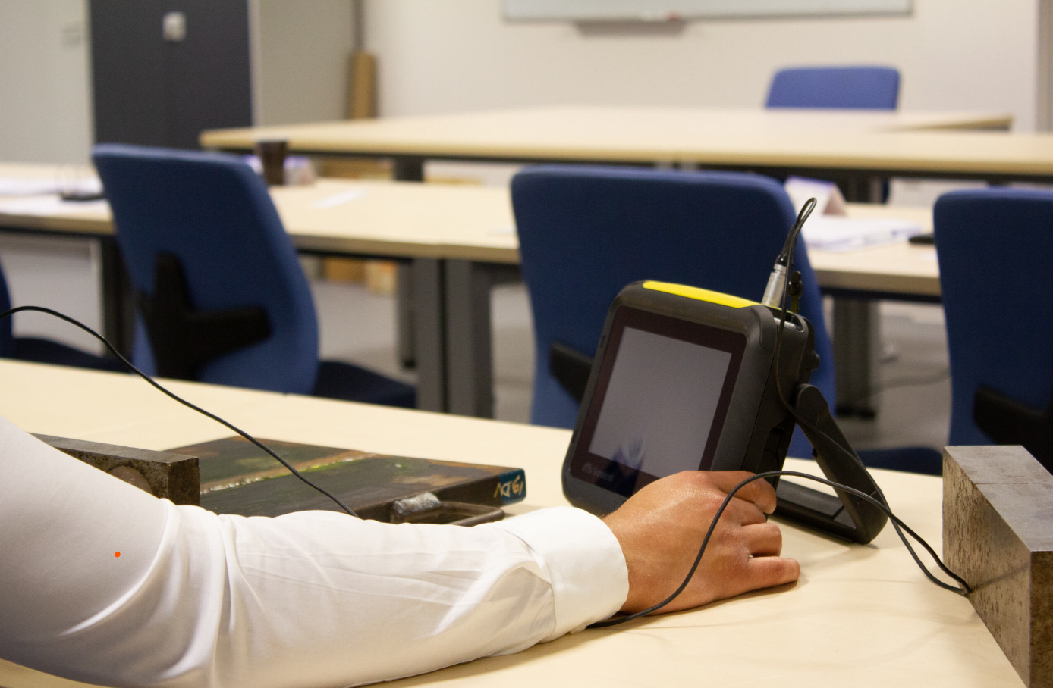
Exam Mode
Who?
Schools
Training and Certification Centers

Slide 16
Training the next generation
WAVE #1 in UK
WAVE – Top 3 across in the Americas, Europe & Asia
The most trusted unit to teach
Now the most trusted unit to certify technician

Slide 17
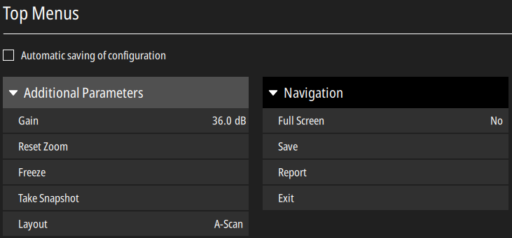
Enhanced Companion
More controls on the UI
Burger menu customisation

Slide 18
Exam Mode - Security
Unique ID and Logo
Can share the app!
Timer Control
PIN code to enforce timer
Connection to wired network stops it

Slide 19
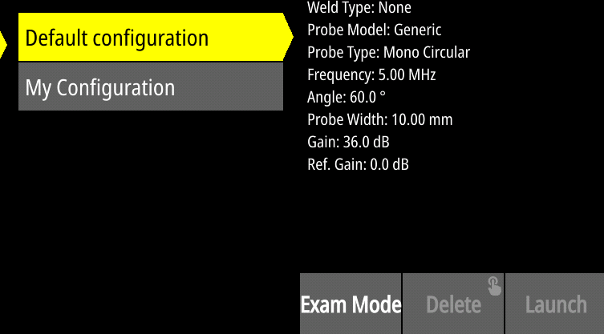
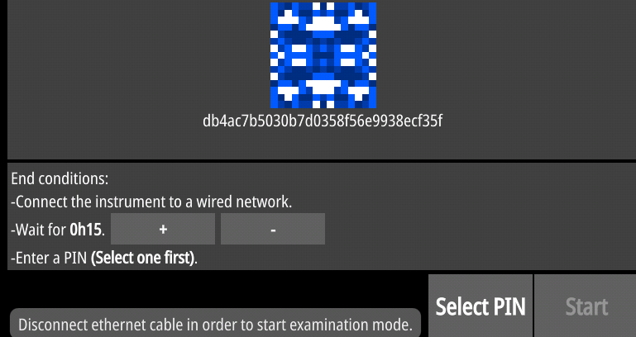
Steps
Create and edit an app and check the Exam Mode
Transfer app to the Wave(s)
Launch the Exam Mode

Slide 20
Cheaters, be aware!
A bell will ring when leaving the exam mode
No other apps can be launched
Any IP connections will trigger the end
One little change will change the ID number

Slide 21
The Last Details
Autocal Dist1 and Dist2 minimum distances went down from 1.0 mm to 0.02 mm (0.039” to 0.001”) for high precision and thin composition applications.
UT range is increased to 30 meters.
BEA zone width allows a new attenuation control. The BEA can be placed between 2 valuable A-scan peaks with no attenuation modification.
T-log row and column headers can be separately set to numbers or letters
AWS C rounding value is now set to the near 0.1 dB value. (Applicable for new configurations)

Slide 22
Thank you!
Available on November the 13th 2024
Don’t forget to download the Companion 2.1!

Slide 23
Become a strategic partner (WIP)
Be “at the table” for senior-leadership discussions and help shape the strategy
By empowering your customer with tailored applications
By hosting a suit of Exam Mode ready in partnership with your local training center

Slide 24
Any Questions?

